Slide 1

The TIF-Lens Series: “Zoom in” on Developing a Future Pathway
Stephanie Sommers and Heather Turngren
ACES Project Team
ATLAS, Hamline University, MN

Slide 2

Who’s who?
Presenters: Stephanie Sommers and Heather Turngren (ACES Project Team, Minneapolis Adult Education Teachers)
Who teaches…
  GED?
  Low/Inter. ABE?
  Low-level ESL?
  Inter/Adv. ESL?
  Multi-level?
  In a 1-room schoolhouse?
Who’s a manager or coordinator?
Who did I miss?
Notes:
Brief introductions: Presenter & who’s in the room? [GED? Low/Inter. ABE? Low-level ESL? Inter/Adv. ESL? Multi-level? Managers? One-room schoolhouse? Etc.] Get show of hands to gauge the audience. Depending on who is in attendance, you may want to have the sample lessons on hand for Beg. ESL & Advanced ESL/ABE. These would be extra handouts and not used for the presentation itself.

Slide 3
AGENDA
Today we will…
Recognize the purpose of the Transitions Integration Framework (TIF)
Explore the Developing a Future Pathways(DFP) category of the TIF and its skills
Use the A-C-E-S process to integrate DFP skills into a lesson
Explore TIF-ing methods to integrate DFP skills into a classroom at all levels
Notes:
Objectives on Title page of handouts, p. 1.

Slide 4
ACES
Academic, Career, & Employability Skills
MISSION
To ensure that ABE programs are able to provide effective contextualized instruction integrating post-secondary education and training readiness, employability skills, and career readiness at all levels.
Notes:
Background: Federal push to focus on transitions in ABE/ESL. Minnesota’s response to make “transitions” relevant for all levels of ESL/ABE. Share the Presenter’s (My) interests and motivations; for example, “I taught FastTRAC and saw students were not able to be a successful because they lacked the Developing a Future Pathway skills they needed.”

Slide 5
Developing a future pathway: Matching Skills & Sub Skills
Read the Developing a Future Pathway (DFP) skills on your handout.
Read through each of the DFP sub skills below.
Decide which DFP skill (1, 2, or 3) goes with each of the sub skills.
Write the number of the skill (1, 2, or 3) in the small box to the left of each sub skill
Check you answers with the DFP snapshot.
Notes:
Refer participants to the matching handout p. 2. After they match the sub skills to skills, have them turn to p. 3 (DFP skills snapshot) and check their answers with the actual DFP skills and sub skills from the TIF @ a Glance.

Slide 6
TIF: Transitions Integration Framework
Complete TIF contains:
  Categories & definitions
  Skills & sub skills
  Sample activities ranging from simple to complex
  Sample technology ideas to practice skills
  Ideas to contextualize for community, school, or work
Outlines the skills needed for successful transitions .
Serves as a guide for integrating transition skills into instruction.
Transitions
Integration
Framework
Notes:
Describe the organization of the TIF.

Slide 7
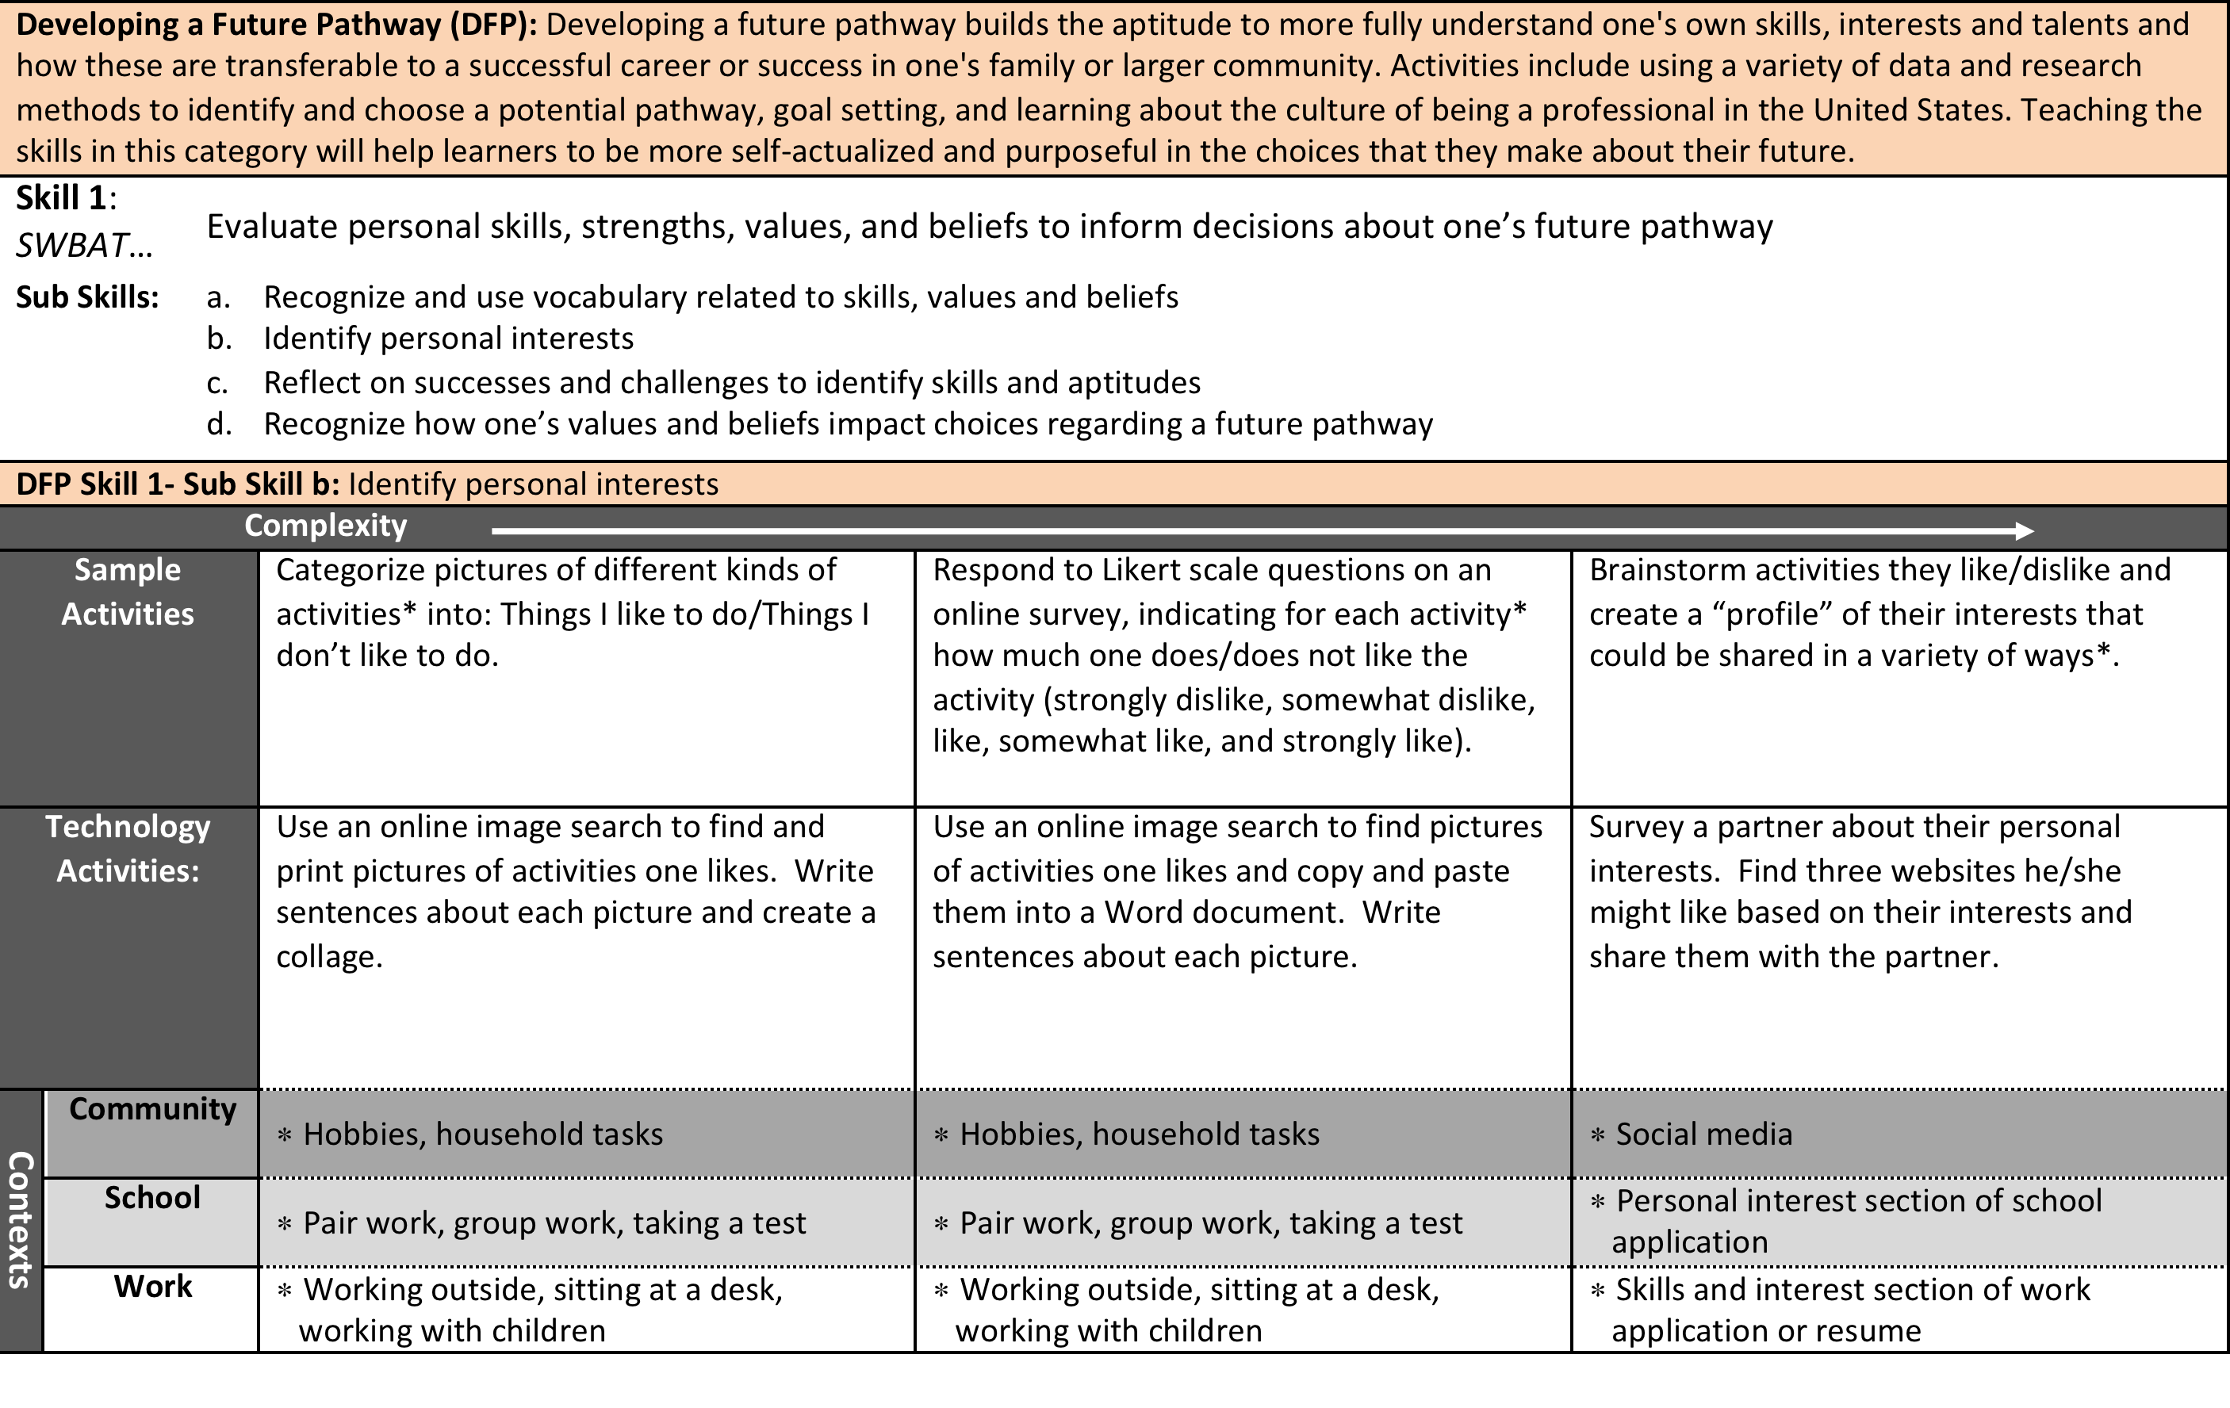
Notes:
Explain the layout of the TIF, indicating the skills, sub skills, sample activities, and contexts. Explain that two sub skills from each skill are exemplified through sample activities on a continuum of complexity. Show how technology sample activities are included for each of these sub skills as well. Refer everyone to the URL included at the bottom of the handout.

Slide 8
“Zoom in” on Developing a Future Pathway: Complete TIF Sample Activities
Given one DFP skill (1, 2, or 3), look at the sample activities provided for that skill.
Look at the column of the grid that most closely corresponds to the level of your students.
Find one sample activity to consider using with your students. (Consider tech examples as well)
Fill out the chart w/ the sub skill, level, activity description and “tweaks” you would make to the activity for you students
Share with the group.
Notes:
Divide the group into groups/pairs divisible by 3 so that an equal number of groups look at one DFP Skill for each of the 3 skills. Assign one skill to each group and refer them to the correct pages of the complete TIF (pp. 56-61) for that skill. Each group will look at only 1 of the 3 skills and then share out their “finds” with the whole group. The whole group can then fill in the remaining 2 rows on their handout during the whole group share.

Slide 9
Give me an A! The ACES Process
ssess instruction/materials/curriculum to identify where TIF skills are addressed
A
C
E
S
omplement to intentionally integrate TIF skills
valuate outcomes after delivering lesson/using materials/trying the activity
tudy and reflect
      What else do students need?
      What else do I need?
Notes:
Reveal each letter in the acronym one at a time and have participants “shout out” what it stands for. “Click” to reveal the answer.

Slide 10
Give me an A! The ACES Process
ssess instruction/materials/curriculum to identify where TIF skills are addressed
A
C
E
S
omplement to intentionally integrate TIF skills
valuate outcomes after delivering lesson/using materials/trying the activity
tudy and reflect
      What else do students need?
      What else do I need?
Notes:
Explain that this workshop will cover only the Assess and Complement steps of the ACES process.

Slide 11
Step 1: assess
Read and ASSESS the Pre A-C-E-S Lesson to determine what DFP skills and sub skills are being addressed
    Look at each lesson component on the Pre & Post ACES side-by-side lesson plan
    Identify the DFP skills and sub skills it addresses. (Refer to the “TIF @ a Glance: DFP Snapshot”)
    Note the skills and sub skills in the “Assess” column for each lesson component (e.g. DFP 1a, 2b)
Share out the skills and sub skills your group identified in the lesson
Notes:
Pass out the “Sample Lesson DFP Intermediate”. Have participants look at the pre & Post ACES side-by-side lesson plan on page 5 and “Assess” each component for DFP skills. Have them refer to the “TIF @ a Glance: DFP Snapshot” (handout p. 3) to identify the DFP skills and sub skills and “GRID 1: TIF-ing a Lesson” (handout p. 6) where they will jot down the skills they identify for this activity.

Slide 12

Pre- ACES Lesson Plan
Warm-Up: Looking for Jobs Brainstorm
Teacher leads students in a brainstorming
activity to think of ways to look for and learn about jobs.
Teacher introduces the concept of an informational interview as a way to learn more about a job.
Notes:
Go step-by-step through each component of the pre-ACES lesson identifying any DFP skills that are addressed. Have participants write the identified skills & sub skills in Grid 1: TIF-ing a Lesson (p. 6).

Slide 13
Pre A-c-e-s Lesson: Assess
Lesson Components | Assess | Complement | Evaluate | Study & Reflect
Warm-Up
Introduction
Guided Practice
Independent Practice
Extension
DFP 3c
Notes:
Have participants check their answers on their grid with this slide. “Click” to reveal the skills one row at a time.

Slide 14
Pre- ACES Lesson Plan
Introduction: Types of Jobs Brainstorm
Students (Ss) brainstorm different types of jobs in small groups. They try to list as many as they can within 5-10 minutes.
The groups share out their ideas while the teacher writes them on the board.
Teacher explains that one way to learn more about a job is by doing research. Today Ss will have the opportunity to research a particular job that is of interest to them.
Notes:
Go step-by-step through each component of the pre-ACES lesson identifying any DFP skills that are addressed. Have participants write the identified skills & sub skills in Grid 1: TIF-ing a Lesson (p. 6).

Slide 15
Pre A-c-e-s Lesson: Assess
Lesson Components | Assess | Complement | Evaluate | Study & Reflect
Warm-Up
Introduction
Guided Practice
Independent Practice
Extension
DFP 3c
DFP 2b
Notes:
Have participants check their answers on their grid with this slide. “Click” to reveal the skills one row at a time.

Slide 16

Pre-ACES Lesson Plan
Guided Practice: Writing Questions
Students (Ss) choose one of the occupations that has been listed. It can be an occupation they are interested in learning more about.
Teacher helps Ss write 7-10 questions that they have about the occupation they have chosen. These questions will serve to guide the students in their research.
Notes:
Go step-by-step through each component of the pre-ACES lesson identifying any DFP skills that are addressed. Have participants write the identified skills & sub skills in Grid 1: TIF-ing a Lesson (p. 6).

Slide 17
Pre A-c-e-s Lesson: Assess
Lesson Components | Assess | Complement | Evaluate | Study & Reflect
Warm-Up
Introduction
Guided Practice
Independent Practice
Extension
DFP 3c
DFP 2b
DFP 2a-2c
Notes:
Have participants check their answers on their grid with this slide. “Click” to reveal the skills one row at a time.

Slide 18

Pre-ACES Lesson Plan
Independent Practice: Student Research
Students (Ss) research their given occupation by reading an article or watching a video:
(Suggested source for an article: www.citytowninfo.com/career-stories)
Ss take notes and try to answer the questions they have written.
Notes:
Go step-by-step through each component of the pre-ACES lesson identifying any DFP skills that are addressed. Have participants write the identified skills & sub skills in Grid 1: TIF-ing a Lesson (p. 6).

Slide 19
Pre A-c-e-s Lesson: Assess
Lesson Components | Assess | Complement | Evaluate | Study & Reflect
Warm-Up
Introduction
Guided Practice
Independent Practice
Extension
Assessment
DFP 3c
DFP 2b
DFP 2a-2c
DFP 2a-2c
NA
DFP 2a-2c
Notes:
Have participants check their answers on their grid with this slide. “Click” to reveal the skills one row at a time.

Slide 20
ACES Process: Step 2: Complement
  Now watch the video clip of the “Post-ACES” TIF-ed lesson one segment at a time. Access video: https://www.youtube.com/watch?v=ZVXETVjmvB4
  How did the teacher COMPLEMENT each segment of the lesson with additional DFP skills and sub skills?
      Refer to the TIF @ a Glance DPF Snapshot.
      Note the skills and sub skills on the GRID in the “complement” column.
  Share out skills & sub skills
Notes:
Post-ACES Lesson
Continue working from the TIF @ a Glance and TIF-ing a Lesson Grid (p. 6). Click the video link to show the video.
Watch the Post-ACES Lesson one segment at a time as indicated on the TIF-ing the Classroom Grid (p. 6) and the slides.
After participants watch each segment, have them refer to the Snapshot and record the DFP skills & subskills on the grid for each segment. Go to next slide & have participants check the skills/sub skills they identified with the PPt slide.

Slide 21
Post-ACES Lesson Plan
Warm-up
Warm-up: [video time: 0:00-5:00]
Teacher leads students in a brainstorming activity to think of ways to look for and learn about jobs.
Teacher introduces the concept of an informational interview as a way to learn more about a job.
Notes:
Which DFP skills did you notice?

Slide 22
Post A-c-e-s: Complement
Lesson Components | Assess | Complement | Evaluate | Study & Reflect
Warm-Up | DFP 3c
Introduction | DFP 2b
Guided Practice | DFP 2a-2c
Independent Practice | DFP 2a-2c
Extension | NA
DFP 3c
Notes:
Participants can share out their ideas for complements. “Click” to reveal the complements for each row, one at a time.

Slide 23
Post-ACES Lesson Plan
Introduction
Introduction: [video time: 5:00-8:03]
Teacher distributes half sheets of paper that give basic information about a job.
Students (Ss) work in pairs or small groups to complete a K-W-L Chart about the job they were given.
Ss work together to make the ‘K’ section of their charts as complete as possible
Notes:
Which DFP skills did you notice?

Slide 24
Post A-c-e-s: Complement
Lesson Components | Assess | Complement | Evaluate | Study & Reflect
Warm-Up | DFP 3c
Introduction | DFP 2b
Guided Practice | DFP 2a-2c
Independent Practice | DFP 2a-2c
Extension | NA
DFP 3c
DFP 1a; 2a-2c
Notes:
Participants can share out their ideas for complements. “Click” to reveal the complements for each row, one at a time.

Slide 25
Post-ACES Lesson Plan
Guided Practice
Guided Practice: [video time: 8:03-17:38]
Ss use the ‘W’ section of their chart to create 7-10 questions about the job.
Teacher helps Ss create the questions as needed.
Working in small groups, Ss choose their best questions to write on a large sheet of poster paper.
Ss share out their questions.
Notes:
Which DFP skills did you notice?

Slide 26
Post A-c-e-s: Complement
Lesson Components | Assess | Complement | Evaluate | Study & Reflect
Warm-Up | DFP 3c
Introduction | DFP 2b
Guided Practice | DFP 2a-2c
Independent Practice | DFP 2a-2c
Extension | NA
DFP 3c
DFP 1a; 2a-2c
DFP 2a-2c
Notes:
Participants can share out their ideas for complements. “Click” to reveal the complements for each row, one at a time

Slide 27
Post-ACES Lesson Plan
Independent Practice
Independent Practice: [video time: 17:38-19:39]
Ss research their given job by reading an article or watching a video: www.citytowninfo.com/career-stories
Ss take notes and try to answer the questions they have written.
Ss complete the 4-Square graphic organizer with information about the job.
Notes:
Which DFP skills did you notice?

Slide 28
Post A-c-e-s: Complement
Lesson Components | Assess | Complement | Evaluate | Study & Reflect
Warm-Up | DFP 3c
Introduction | DFP 2b
Guided Practice | DFP 2a-2c
Independent Practice | DFP 2a-2c
Extension | NA
DFP 3c
DFP 1a; 2a-2c
DFP 2a-2c
DFP 1a-1b; 2a-2c
Notes:
Participants can share out their ideas for complements. “Click” to reveal the complements for each row, one at a time.

Slide 29
Post-ACES Lesson Plan
Extension
Extension: [Not featured in video]
Help Ss to write a letter or e-mail to someone who works in the job that they researched. Ss ask 3-5 questions requesting more information about the job.
Ss prepare short presentations for the class in which they give 3-5 pieces of information that they learned from reaching out to someone in a given job.
Notes:
Which DFP skills did you notice?

Slide 30
Post A-c-e-s: Complement
Lesson Components | Assess | Complement | Evaluate | Study & Reflect
Warm-Up | DFP 3c
Introduction | DFP 2b
Guided Practice | DFP 2a-2c
Independent Practice | DFP 2a-2c
Extension | NA
DFP 3c
DFP 1a; 2a-2c
DFP 2a-2c
DFP 1a-1b; 2a-2c
DFP 2b-2c; 3a
Notes:
Participants can share out their ideas for complements. “Click” to reveal the complements for each row, one at a time.

Slide 31
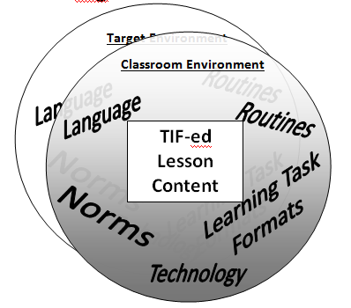
TIF-ing your classroom
Notes:
Refer participants to the handout p. 7. Explain how the visual represents an “overlay” to the target environment.

Slide 32
TIF Methods Definitions
Routines: a sequence of actions regularly followed; a routine process
Norms: standards of acceptable behavior; expectations within a specified context
Learning Task Formats: routine structures for activities and tasks that provide practice of lesson content
Language: vocabulary and language structures that are necessary to effectively address a specified TIF skill
Technology: technology use that mirrors what is necessary in the “target” environment.
Notes:
Read through and explain the different TIF methods. (Handout p. 7)

Slide 33
Which TIF method is which?
TIF methods can be labeled in more than one way:
  Expecting students to email assignments is both technology and a norm.
  Expecting students to speak courteously is a norm but when you highlight the language structures (e.g. Could/can/may I…), it is also a language method.
The important thing is that all of these methods reinforce TIF skills consistently and authentically regardless of lesson content.
Notes:
Offer or elicit other examples as needed.

Slide 34
Which is Which? Group Activity
Look at the example of each TIF method on the following slides
Although there is one primary method for each example, they may match to other methods as well.
Prepare to give a rationalization for matching the methods the way you did.
Notes:
Time-Permitting: Pass out the “DFP TIF-ing Methods Activity” matching activity (prepared beforehand and cut into sets) to small groups or pairs. Use the following 5 slides to check matches and have groups share out other opinions or suggestions.
No Time? Simply share one example of each TIF-ing method by showing the next 5 slides.

Slide 35
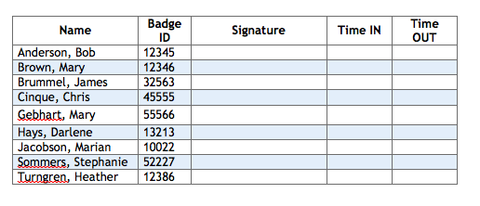
Routine!
Name That TIF Method!!
Example 1: Daily Sign in Sheets
Students practice a work skill of signing in and out accurately with the correct time and signature.
Notes:
Click to fly in the question. Click to reveal the answer.

Slide 36
norm!
Name That TIF Method!!
Example 2: Teamwork
Working with a team is an important part of education and the workplace. In this class, you will often be required to work in a team. It is important that you take responsibility for your role in the team and complete the tasks you agree to do. It is also important to participate in the group discussions, giving your input in a positive and constructive way.
Notes:
Click to fly in the question. Click to reveal the answer.

Slide 37
Name That TIF Method!!
language!
Example 3: Using Polite Language and Tone
It is an expectation in this class that we treat each other with respect and courtesy. One way to show respect is to make requests using polite language and tone. When you need help or simply want to get clarification, using the following phrases is the courteous way to achieve this:
I would like... --Instead of -- I want/need…
Could you…/Can you… --Instead of -- Give me…
Could I…/Can I…/May I… --Instead of -- I’m going to…
Notes:
Click to fly in the question. Click to reveal the answer.

Slide 38
Learning Task Format!
Name That TIF Method!!
Example 4: Using a Writing Journal
Teacher puts a weekly prompt on the board
Ss respond to the prompt in their designated writing journal/notebook – Ss had to keep writing for the entire time period
Teacher writes a short response
NOTE: weekly prompts are about careers and interests
Notes:
Click to fly in the question. Click to reveal the answer.

Slide 39
Name That TIF Method!!
Technology!
Example 5: Schoology – Online Class Management System
Teacher creates assignments in Schoology
Ss log in to Schoology in the computer lab and complete work
Ss can submit assignments, post in discussions, take an online quiz, etc.
Teachers can link students to outside resources pertaining to career exploration or training opportunities
Notes:
Click to fly in the question. Click to reveal the answer.

Slide 40
Think-Pair-Share:
TIF-ing your Classroom: Discussion
1. What is a TIF method in your classroom that already addresses one or more of the DFP sub skills?
2. Briefly describe it to your partner.
Notes:
Time permitting: Have participants volunteer to share out a TIF method from their class.

Slide 41

ACES 6-pack ABES*!
The Muscle Behind the mission!
*Adult Basic Education Support
ACES Resource Library 6-pack: www.atlasabe.org/resources/aces
  Pre & Post A-C-E-S Lesson Plan (3-pack)
  TIF-ed Lesson Video
  PowerPoint with Workshop Handouts and Activities
  Bonus pack of TIF methods
ACES Face-2-Face PLC s
ACES Hybrid PLCs
ACES Regional Workshops
ACES Webinars
ACES Collaborations
Notes:
Share the adult basic education support (ABES) available to practitioners in MN.

Slide 42
ACES Resource library
ACES Transitions Integration Framework (TIF) at ATLAS website: www.atlasabe.org/professional/transitions
  Complete TIF with sample activities and technology activities
ACES PLC and Support Materials
  www.atlasabe.org/resources/aces
  Under construction: Sample pre and post TIF-ed lessons and classroom videos for each category of the TIF
Notes:
Share that all resources from today’s workshop are located here. Info on title page of handout, p. 1.

Slide 43
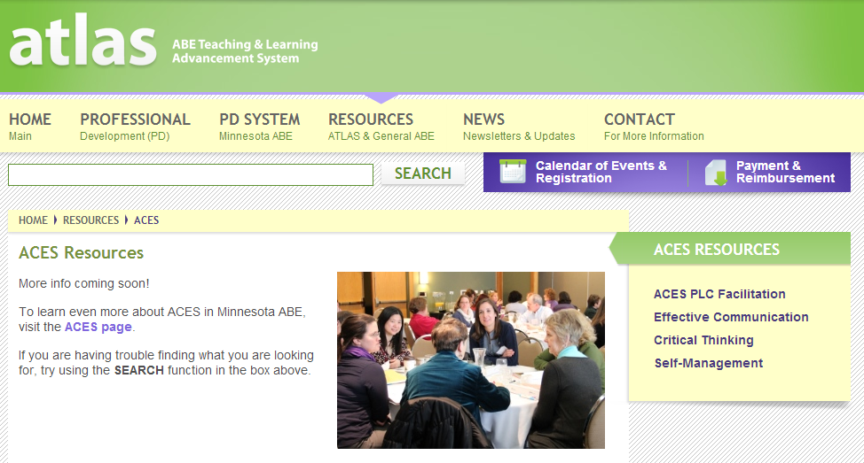
ACES Resource library
http://atlasabe.org/resources/aces
Notes:
If there is internet access, go to the link and demo what is available: PLC materials and category-specific materials

Slide 44

Thank you!!
ATLAS/Hamline

