Slide 1
ACES Professional Learning Community II Meeting THREE
Notes:
Handouts:
ACES PLC II Participant Workbook (Complete document 3-hole punched in 3-ring binder--Recommended; or pp. 17-25)
The Complete TIF (Complete document or pp. 14-21)
TIF at a Glance (Complete document or pp. 3-4)
Materials/Technology:
Go-To-Training
Headphones & microphone

Slide 2
Welcome Back…Webinar Style!
Introductions of the host and facilitator
Who’s present?
Who’s ready to go?
Speakers working?
Microphone?
Check out the “mute” webinar tool
& make sure you are muted.
When you’re called on, unmute yourself, introduce yourself, and re-mute.
Ready, Set, Go-To!
Notes:
Welcome Back (3 min)
Slide 2
Welcome participants. Introduce yourself (facilitator) and the host. Check in with each participant to make sure they can hear and then explain the mute/unmute feature and have everyone mute themselves. Explain that you will call on each participant so that they can introduce themselves. Have them unmute when they are called on and re-mute afterwards.
Remind everyone that this meeting will focus on Navigating Systems (NS).

Slide 3
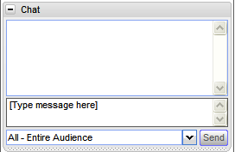
Meeting THREE Agenda & Webinar Tools
ACES Goal Checkpoint > Poll
Sharing Outside Task #4: 3 volunteers?
Sharing Outside Task #5: 3 volunteers?
Navigating Systems Match It! > Quiz
Sharing Outside Task #6: 3 volunteers?
Video: The ACES Process: The Classroom
Open new tab:
Watch the video segment for the specified time.
Return to the webinar and Chat
Interview Script: The ACES Process: Corrections
Read the interview script/slides
How does this context relate to your own? Partner Chat
TIF Methods & Share out: 3 volunteers?
ACES Journey Discussion:
ACES & CCRS
Notes:
Agenda & Webinar Tools (3 min) (handout p. 19)
Go over each agenda item and have participants preview and practice the webinar feature to be utilized. Secure 3 different participants to share out for each of the Outside Tasks (see notes below for more information).
Warm-up: ACES Goal Checkpoint > Poll
Sharing OT #4 > Hands up; 3 volunteers
Show the “hands up” icon and have 3 participants volunteer with a “hands up” to share OT #4 when we come to that item. Jot down their names.
Sharing OT #5 > Hands up; 3 volunteers
Have 3 participants volunteer with a “hands up” to share OT #5 when we come to that item. Jot down their names.
NS Match it! > Quiz
Sharing OT #6 > Hands up; 3 volunteers
Have 3 participants volunteer with a “hands up” to share OT #6 when we come to that item.
The ACES Process: The Classroom > Video: Have participants open a new tab and access video link. Explain that they will need to go to this tab & watch the video when we get to that portion of the webinar.
The ACES Process: Corrections > Interview script (extra handout in materials section of webinar tools). Partner Chat > Show them how to chat w/ a participant and explain that they will chat with a PLC partner for this activity. Have them practice by sending a chat message to a PLC partner.
TIF Methods & Share out > Hands up-unmute-mute
ACES Journey Discussion > Hands up-unmute-mute
ACES & CCRS > Presenter
Wrap up & Q & A > Hands up-unmute-mute

Slide 4
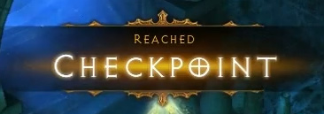
Goal Checkpoint?
Look back at your ACES goal on page 12.
How would you rate your progress?
I’ve arrived!
Almost there!
Making progress…
Goal? What goal?
Notes:
Poll: ACES Goal Checkpoint
(5 min) (Go-To-Training Poll, HO: p. 12)
Launch the Poll: ACES Goal Checkpoint
Participants will rate their progress towards their ACES Goal on p. 12.
Share the poll.

Slide 5
TIF-ed Lesson: Try it Out 2! – Outside Task #4
Share Out! 3 volunteers?
Briefly share your TIF-ed Lesson experience.
Give a brief description of your lesson, including the TIF skills you addressed.
What was the highlight of the lesson?
What ‘evidence’ of student learning did you observe?
Notes:
TIF-ed Lesson: Try it Out! Outside Task #2. (10 min)
Google Drive: If your group is using Google drive, show this doc during this activity.
Call on each of the participants who volunteered to share. Have them unmute themselves and address the questions on the slide.
Have other participants chat any comments or questions they have. Read these to the person sharing out so that they can address them. Then have them re-mute themselves.
Guiding Questions:
What LS skills did it integrate?
What did the lesson entail?
How did the lesson go? What evidence of learning did you observe?
What went well? What would you do differently next time?

Slide 6
TIF-ed Method Implementation– Outside Task #5
Share Out! 3 volunteers?
Briefly share your TIF methods implementation experience.
Give a brief description of the method you integrated, including the TIF skills you addressed.
What was the highlight of the lesson?
What evidence of student learning did you observe?
Notes:
TIF Method Implementation Outside Task #5. (10 min)
Google Drive: If your group is using Google drive, show this doc during this activity.
Call on each of the participants who volunteered to share. Have them unmute themselves and address the questions on the slide.
Have other participants chat any comments or questions they have. Read these to the person sharing out so that they can address them. Then have them re-mute themselves.
Guiding Questions:
Describe your TIF method.
What LS skills did it integrate?
How did the implementation go? What evidence of learning did you observe?
What went well? What would you do differently next time?

Slide 7
Navigating Systems Matching Skills & Sub Skills
It’s a QUIZ!
One of your Outside Tasks was to preview the Navigating Systems (NS) category of the TIF
The NS category contains 3 skills with each skill broken down into sub skills
Match each sub skill to the appropriate skill.
Notes:
Quiz: LS Match it!
(5 min) (Go-To-Training Quiz)
Launch the quiz. Have participants match each NS sub skill with its parent skill.
Share the test results.

Slide 8
Review the Preview! Outside Task #6
NS Skill 1- Sub Skill a: Identify and utilize resources (print, electronic, and human) that aid in navigating specific systems (e.g., employee handbooks, HR department, student support services)
Complexity
Sample Activities |  | Develop a list of questions to ask when visiting a particular place of interest* for the first time. Brainstorm a list of resources for finding answers to the questions. Choose one of those resources and explore it with a partner. | Role play calling a particular place* and asking questions about the services they offer. Produce follow-up questions to gain more information. | Contact (by phone, online, or in person) a particular place of interest* in order to learn more about the services they offer. Summarize the information gathered for a larger audience.
Technology Activities: |  | Scan printed web pages and circle the information needed. Visit the actual website and match circled information on print handout to actual information on website. | Find a phone number for a particular place* through a simple online search. | Find a phone number for a particular place* through a simple online search or the ‘contact’ page of the place’s website. Contact that place to learn more about the services they offer. Summarize the information gathered for a larger audience.
Contexts | Community | Grocery store, bank, library | Grocery store, bank, library | Bank, county services,
 | School | Child’s school, college | Child’s school, college | Child’s school, college
 | Work | workforce center, temp agency | workforce center, temp agency | workforce center, temp agency
TIF Category: Navigating Systems
TIF Skill/Sub Skill | Level | Activity Description | How will you tweak it?
Skill 1a | Inter. | Role play calling a particular place and asking questions about the services they offer. | Work in groups to develop questions for role play. Check for accuracy.
Notes:
OT #6: NS Sample Activities: The Complete TIF (pp. 62-67)
(10 min) (handout p. 26) (Slides 8-9)
Review the directions for the TIF preview activity.

Slide 9
Preview Activity: the Complete TIF
Share Out!
You navigated the complete TIF to find sample activities for the NS sub-skills.
What did you find?
How did you tweak it?
3 volunteers please!
Transitions
Integration
Framework
Notes:
Preview Activity: The Complete TIF (10 min-slides 8-9) (handout p. 26)
Call on each of the participants who volunteered to share. Have them unmute themselves and address the questions on the slide.
Have other participants chat any comments or questions they have. Read these to the person sharing out so that they can address them. Then have them re-mute themselves.
Guiding Questions:
What did you find?
How did you tweak it?

Slide 10
A Tale of Two Contexts…
Corrections
The Classroom
Notes:
Tale of TWO Contexts
(30 min)
Slides: 10-30; HO pp. 29-31; (TIF @ a Glance, p. 12)
Explain that we will look at applying the ACES process to the contexts of the classroom and corrections, this time looking at the NS category (TIF @ a Glance, p. 12).
Context: The Classroom

Slide 11
ACES Process: Step 1: Assess a Lesson Sample “Pre-ACES” Lesson
Read and ASSESS the Pre A-C-E-S Lesson Plan to identify the Navigating Systems (NS) skills/sub skills being addressed.
Read the description of each lesson component and identify the NS skills and sub skills addressed.
Refer to the “TIF @ a Glance” NS category (p. 12).
Note the skills and sub skills in the “Assess” column for each lesson component (e.g. NS 1a, 2b)
Remember, the ACES process can be used with textbook materials, learner plans, and other instructional resources and routines, not just lesson plans.
ACES can work in any ABE context!
Notes:
ACES Process: The Classroom
Slides: 11-19; HO pp. 29-31; TIF @ a Glance p. 12
Share the pre-ACES LS lesson and together identify the skills and sub-skills it addresses. Jot down on grid (p. 29). (Participants will chat the skills they notice in the lesson segments.)

Slide 12
Pre-ACES Lesson Plan Warm-up
Warm-up:
NA
Notes:
What NS skills do you see?

Slide 13
Pre A-c-e-s Lesson: Assess
Lesson Components | Assess | Complement | Evaluate | Study & Reflect
Warm-Up
Introduction
Guided Practice
Independent Practice
Extension
NA
Notes:
Have participants check their answers on their grid with this slide. “Click” to reveal the skills one row at a time.

Slide 14
Pre-ACES Lesson Plan Introduction
Introduction:
Explain the basic concept of a learning styles inventory to Ss.
Brainstorm with Ss examples of each learning style and what it could look like in a classroom setting.
Explain to Ss that they are going to have an opportunity to take a learning style inventory online to help them determine how they may best learn.
Notes:
What NS skills do you see?

Slide 15
Pre A-c-e-s Lesson: Assess
Lesson Components | Assess | Complement | Evaluate | Study & Reflect
Warm-Up
Introduction
Guided Practice
Independent Practice
Extension
NA
NS 1a
Notes:
Have participants check their answers on their grid with this slide. “Click” to reveal the skills one row at a time.

Slide 16
Pre-ACES Lesson Plan Guided Practice
Guided Practice:
Model with Ss how to use the online learning style inventory.
Remind Ss they should think about the statement carefully before choosing their answer.
Model how to submit answers and review the corresponding learning style inventory.
Notes:
What NS skills do you see?

Slide 17
Pre A-c-e-s Lesson: Assess
Lesson Components | Assess | Complement | Evaluate | Study & Reflect
Warm-Up
Introduction
Guided Practice
Independent Practice
Extension
NA
NS 1a
NS 1a
Notes:
Have participants check their answers on their grid with this slide. “Click” to reveal the skills one row at a time.

Slide 18
Pre-ACES Lesson Plan Independent Practice
Independent Practice:
Ss will perform an online learning style inventory.
Help Ss complete the learning style inventory (note or print results as needed).
The online learning style inventory (http://www.personal.psu.edu/bxb11/LSI/LSI.htm) consists of 24 questions and should take about 10 – 15 minutes.
Notes:
What NS skills do you see?

Slide 19
Pre A-c-e-s Lesson: Assess
Lesson Components | Assess | Complement | Evaluate | Study & Reflect
Warm-Up
Introduction
Guided Practice
Independent Practice
Extension
NA
NS 1a
NS 1a
NS 1a
NA
Notes:
Have participants check their answers on their grid with this slide. “Click” to reveal the skills one row at a time.

Slide 20
ACES Process: Step 2: Complement
Now watch the video clip of the “Post-ACES” TIF-ed lesson. https://www.youtube.com/watch?v=V9t1z23_Y40&feature=em-uploademail
Open a new tab in your browser to access the video:
Watch the video for the allotted time & return to the webinar
How did the teacher COMPLEMENT the lesson with additional NS skills and sub skills?
Refer to the TIF @ a Glance NS Snapshot.
Note the skills and sub skills on the GRID in the “complement” column
Be prepared to chat the skills/sub skills you jotted on the grid.
Notes:
Post-ACES Lesson
Slides 20-30; HO pp. 29-31; TIF @ a Glance p. 12
Watch the Post-ACES Lesson one segment at a time as indicated on the TIF-ing the Classroom Grid (p. 29) and the slides. (Note: You can cut these segments down to save time.) Link:
Warm-up:
Introduction:
Guided Practice:
Independent Practice: -end
Extension: Not featured in video
Identify the skills & sub skills from each segment and jot them on the grid (p. 29) after watching each segment.
Check your notes with the slides.
Reflect on the ‘E’ and ‘S’ of the ACES Process for this lesson

Slide 21
Post-ACES Lesson Plan Warm-up
Warm-up: [0:00-7:10]
Brainstorm with Ss on learning styles and methods of learning. Try to elicit examples of each learning style and what it could look like in a classroom setting. (Visual = seeing and reading – Auditory = listening and speaking – Kinesthetic/Tactile = touching and doing)
Watch this segment from a different tab. Then return to the webinar to chat.
Notes:
What NS skills did you see?

Slide 22
Post A-c-e-s: Complement
Lesson Components | Assess | Complement | Evaluate | Study & Reflect
Warm-Up | NA
Introduction | NS 1a
Guided Practice | NS 1a
Independent Practice | NS 1a
Extension | NA
NA
Notes:
Participants can share out their ideas for complements. “Click” to reveal the complements for each row, one at a time.

Slide 23
Post-ACES Lesson Plan Introduction
Watch this segment from a different tab. Then return to the webinar to chat.
Introduction: [7:10-9:04]
Explain to Ss that they will take a learning style inventory online to help them determine how they may best learn.
Model with Ss the online learning style inventory.
Remind Ss they should think about the statement carefully before choosing an answer.
Model how to submit answers and review the corresponding learning style inventory.
Ss then perform their own learning style inventory and record results.
Notes:
What NS skills did you see?

Slide 24
Post A-c-e-s: Complement
Lesson Components | Assess | Complement | Evaluate | Study & Reflect
Warm-Up | NA
Introduction | NS 1a
Guided Practice | NS 1a
Independent Practice | NS 1a
Extension | NA
NA
NS 1a
Notes:
Participants can share out their ideas for complements. “Click” to reveal the complements for each row, one at a time.

Slide 25
Post-ACES Lesson Plan Guided Practice
Watch this segment from a different tab. Then return to the webinar to chat.
Guided Practice: [9:04-13:12]
Explain to Ss that they will do a jigsaw reading on learning style inventories and strategies
Put Ss into 3 groups based on their learning style Group A=auditory learners, Group B= visual learners, Group C=tactile/kinesthetic learners
Distribute the various parts of the handout to the groups. They will follow the directions.
Ss present their sections to the class while other Ss take notes on each style presented.
Notes:
What NS skills did you see?

Slide 26
Post A-c-e-s: Complement
Lesson Components | Assess | Complement | Evaluate | Study & Reflect
Warm-Up | NA
Introduction | NS 1a
Guided Practice | NS 1a
Independent Practice | NS 1a
Extension | NA
NA
NS 1a
NS 1a; 2b; 2d
Notes:
Participants can share out their ideas for complements. “Click” to reveal the complements for each row, one at a time.

Slide 27
Post-ACES Lesson Plan Independent Practice
Independent Practice: [13:12-16:30]
Ss will review material pertaining to their own learning style and develop a plan that includes strategies that support their preferred method of learning.
Ss will fill out information in Educational Plan and Testing Log document.
Watch this segment from a different tab. Then return to the webinar to chat.
Notes:
What NS skills did you see?

Slide 28
Post A-c-e-s: Complement
Lesson Components | Assess | Complement | Evaluate | Study & Reflect
Warm-Up | NA
Introduction | NS 1a
Guided Practice | NS 1a
Independent Practice | NS 1a
Extension | NA
NA
NS 1a
NS 1a; 2b; 2d
NS 1a; 2b; 2d-2e
Notes:
Participants can share out their ideas for complements. “Click” to reveal the complements for each row, one at a time.

Slide 29
Post-ACES Lesson Plan Extension
Extension: [16:30-17:46]
Ss will use the Education Plan and Testing Log with teacher during conferences.
After a few weeks of learning plan implementation, Ss will reflect on the plan and make adjustments as needed.
Watch this segment from a different tab. Then return to the webinar to chat.
Notes:
What NS skills did you see?

Slide 30
Post A-c-e-s: Complement
Lesson Components | Assess | Complement | Evaluate | Study & Reflect
Warm-Up | NA
Introduction | NS 1a
Guided Practice | NS 1a
Independent Practice | NS 1a
Extension | NA
NA
NS 1a
NS 1a; 2b; 2d
NS 1a; 2b; 2d-2e
NS 1a; 2b; 2d-2e
Notes:
Participants can share out their ideas for complements. “Click” to reveal the complements for each row, one at a time.

Slide 31
Corrections
Read the interview script (extra handout).
Read about the system she uses to TIF the lessons for her learners.
What kind of IPT does she use? How does she use it?
What kinds of pre-ACES materials does she use and how does she TIF them?
Notes:
A Tale of Two Contexts: The ACES Process
Corrections
(20 min)
Slides: 31-32; HO p. 16; Extra HO: Correction’s Instructor Interview
Read the interview script from an instructor in corrections (extra handout).
Read about the system she uses to TIF the lessons for her learners.
What kind of instructional planning tool does she use in this setting? How does she use it?
What kinds of pre-ACES materials does she use and how does she TIF them?

Slide 32
What works best in my setting?
Partner Chat!
Consider both the classroom and the corrections contexts. Chat with a partner.
Which process would work best in your setting? (Classroom, corrections, other?)
Why did you choose that option?
How would you tweak either process to better fit your setting and learners?
Is there a way to combine the two processes to get the best of both worlds?
Notes:
What’s the Right Fit for My Context?
HO p. 16
Revisit notes from PLC Meeting ONE (p. 16)
Have participants chat with a partner by choosing a participant’s name in the chat box. Have them discuss the following questions:
Which process would work best in your setting? (Classroom, corrections, other?)
Why did you choose that option?
How would you tweak either process to better fit your setting and learners?
Is there a way to combine the two processes to get the best of both worlds?

Slide 33
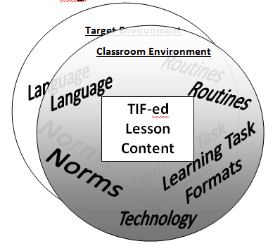
TIF Methods
Notes:
TIF Methods
(15 min)
Slides: 33-35; HO pp. 22-23 & p. 32; TIF @ a Glance p. 12
TIF Methods:
Refer participants to handouts pp. 22-23
Review the TIF Methods visual and then the definitions on the following slide.

Slide 34
TIF Methods Definitions: Matching
Routines
a sequence of actions regularly followed; a routine process
standards of acceptable behavior; expectations within a specified context
routine structures for activities and tasks that provide practice of lesson content
vocabulary and language structures that are necessary to effectively address a specified TIF skill
technology use that mirrors what is necessary in the “target” environment.
Norms
Learning Task
Formats
Language
Technology
Notes:
“Fly in” one definition at a time on slide 34 and have participants “Chat” the type of TIF method given each definition. “Fly in” each answer.

Slide 35
Sharing TIF methods…
Now it’s your turn to think of some TIF Method examples!
Look at p. 32. Jot down 1-2 examples you use/could use.
3 Volunteers! Share out your examples and assessment for skills/sub skills. Other participants, feel free to comment.
Notes:
HO p. 32; TIF @ a Glance p. 12
Have participants look at p. 32 and individually jot down 1 to 2 examples of TIF methods they could implement in their settings to integrate NS skills.
Call on each of the participants who volunteered to share. Have them unmute themselves and follow the directions on the handout.
Have other participants chat any comments or questions they have. Read these to the person sharing out so that they can address them. Then have them re-mute themselves.
Directions:
Describe TIF methods
Assess the methods for NS skills and sub skills

Slide 36
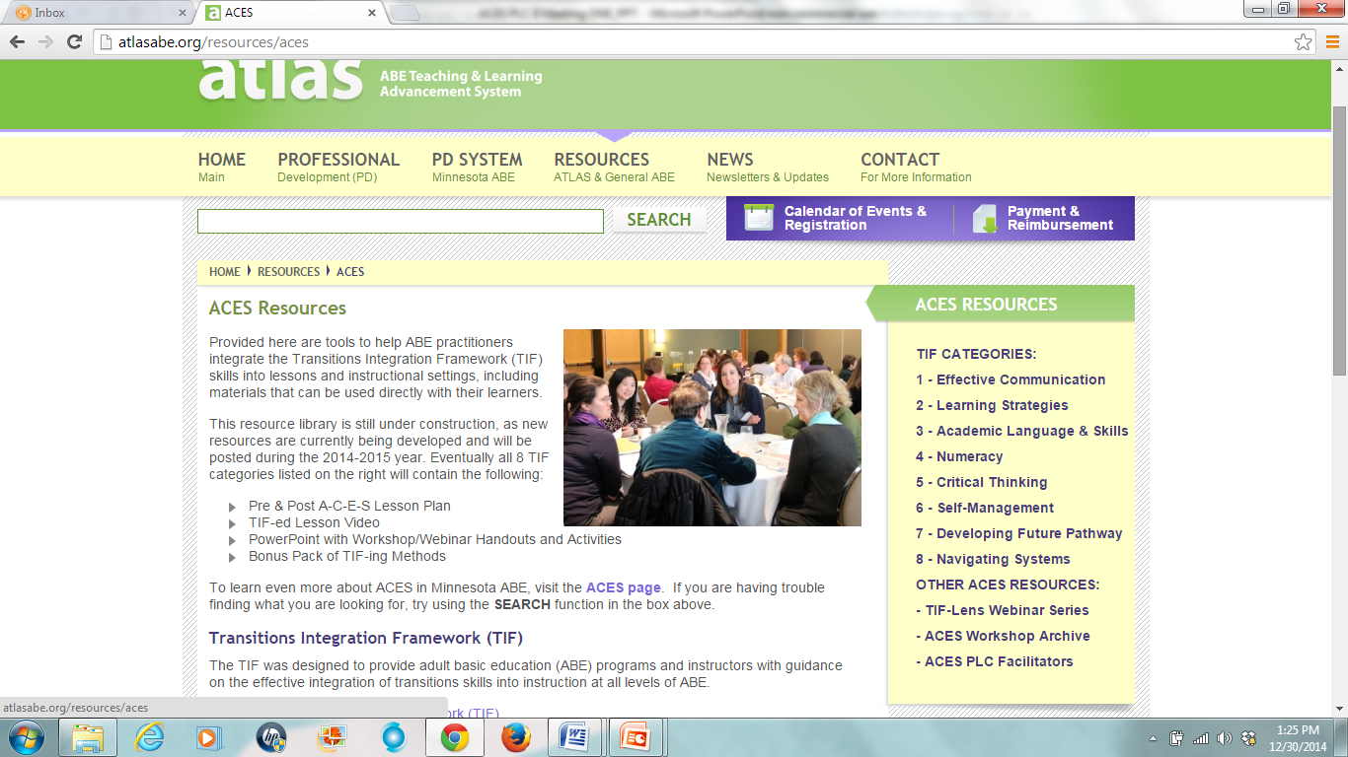
ACES Resource Library
http://atlasabe.org/resources/aces
Notes:
Wrap-up/Q & A
(2 min)
Slide: 36
Share the ACES resource library for the NS category.

Slide 37
Next Steps: Share Out!
Take some time to reflect on your ACES work.
Where did you start with ACES?
What challenges did you face?
How do you feel about your progress as an ACES practitioner?
Did you meet your ACES goal in this PLC? Why or why not? (p. 12)
What are your next steps for ACES?
Notes:
ACES Journey
(7 min)
Slide: 37; HO p. 12
Revisit participants ACES goals. This time have participants discuss their overall ACES journey and their next steps with ACES:
Where did you start with ACES?
What challenges did you face?
How do you feel about your progress toward becoming an ACES practitioner?
What challenges have you overcome?
Did you meet your ACES goal in this PLC? Why or why not? (Handout p. 12)
What are your next steps for ACES?

Slide 38
ACES & CCRS
The TIFs transferable transitions skills complement CCRS academic-based skills.
Academic Language & Skills and Numeracy aligned. Effective Communication, Learning Strategies, and Critical Thinking also support CCRS skills.
Notes:
ACES & CCRS:
(3 min)
Slides: 38-39
Discuss the alignment between ACES and the College & Career Readiness Standards (CCRS).
Explain that the College Career & Readiness Standards are the new instructional standards for ABE in Minnesota. Explain that many of these standards in the CCRS are already being addressed through other professional development venues, such as Minnesota Numeracy Initiative (MNI), STAR Reading and Evidence Based Reading Instruction (EBRI), GED professional development, and, of course, the ACES project. Discuss how the TIF provides a framework for the transferable transitions skills required for employability, career, post-secondary education & training, and increased involvement with community and family. As the CCRS does not contain most of these essential transitions skills, the TIF nicely complements the academic-based skills addressed in the CCRS. Furthermore, it aligns with the CCCRS in the categories of Academic Language & Skills and Numeracy and to a lesser degree Effective Communication, Learning Strategies, and Critical Thinking.

Slide 39
A-C-E-S Process & CCRS
The A-C-E-S Process (Assess, Complement, Evaluate, Study & Reflect) can be used with any set of standards.
Start with an existing lesson or lesson materials.
Assess the lesson for CCRS standards it already addresses
Complement the lesson/materials with additional CCRS standards
Evaluate the lesson using evidence of student learning
Study & Reflect…What more do I/my students need?
Notes:
ACES Process & CCRS
Discuss how the ACES process can be used with any standards. As we begin to integrate the CCRS standards into our teaching, we can directly apply the skills we developed through this ACES PLC by following the steps in the ACES process. Through the ACES process, we discovered that we already integrate many TIF skills into our instruction and that by being intentional about it, we can add more to our repertoire. The same thing will be true as we begin to work with CCRS. We will discover that we already integrate many CCRS standards and that with some intentional modifications, we can integrate more.

Slide 40
CEUs for You!
Your PLC facilitator will fill out a report
to request CEUs for PLC work completed (http://atlasabe.org/resources/aces/aces-plcs)
Here’s the breakdown:
One 3-hour f2f PLC meeting = 3 CEUs
Two 2-hour PLC webinars = 4 CEUs (2 each)
Pre-Tasks #1- #2 = 2 CEUs
Outside Tasks #1- #3 = 3 CEUs
Outside Tasks #4- #6 = 3 CEUs
TOTAL: =15 CEUs
Notes:
Wrap-up/Q & A
(2 min)
Slides: 40-41
Explain that you will submit a report to get CEUs for them according to the completion of the following elements:
F2F PLC meeting ONE: 3 CEUs
Webinar meetings: 4 CEUs (2 each)
Pre-Tasks #1-3: 2 CEUs
Outside Tasks #1-3: 3 CEUs
Outside Tasks #4-6: 3 CEUs
TOTAL = 15 CEUs
Answer questions.
Thank everyone for participating.

Slide 41
Thank you & Wrap-up
THANK YOU for participating in an ACES Professional Learning Community!
miigwech
Notes:
Wrap up & Q&A
Answer questions.
Thank everyone for participating.

