Slide 1

ACES Professional Learning Community,
Meeting TWO
Notes:
Handouts:
Agenda (p. 20)
Warm-up Activity Grid (p. 21)
Learner Observation Notes (Outside Task #1 from PLC Meeting #1)
TIF-ed Lesson: Try it Out! (Outside Task #2 from PLC Meeting #1)
Evidence of Student Learning (p. 22)
Study and Reflect (p. 23)
TIF-ing the Classroom Visual & Grid (pp. 24-26)
TIF-ing Methods (Outside Task #3) (p. 27)
TIF-ed Lesson: Try it Out 2! (Outside Task #4) (p. 28)
Lesson Observation through TIF Lens (Outside Task #5) (p. 29)
Activity Materials & Technology:
Warm-up Activity Matching Sets (Prepared beforehand: pp. 2-8)
Ideal ACES Practitioner Posters from PLC Meeting ONE & Markers
TIF-ing Methods Matching Activity Sets (Prepared beforehand: pp. 10-15)
Projector (preferred)
Internet access (required)

Slide 2
Meeting Two Agenda
Welcome, re-introductions as needed
Sharing Outside Task #1
ACES Process & Outside Task #2
Video: Evidence of Student Learning
TIF-ing the Classroom
Routines, Norms, & Learning Task Formats
Next Outside Tasks
Wrap-up, questions, & plans for Meeting Three
Notes:
Agenda & Re-introductions (5 min)
Hand out the PLC Meeting 2 agenda (Handout p. 20). Go over the agenda, beginning with a check-in to ensure outside tasks were completed. If the tasks were not completed, express that much of the work that will be done in the PLC will be discussing these outside tasks. Quickly visit what meeting 3 will consist of.

Slide 3

Warm-up Activity
Analyze a sample activity that addresses one category of the TIF. Match it to the appropriate TIF category.
Note which skills and sub skills it addresses on the grid.
Repeat!
Notes:
Warm-up Activity (Activities pp. 2-8; Handout p. 21) (10 min)
In pairs or small groups (other than their working group) analyze a sample activity that focuses on one category of the TIF (EC, CT, SM). Match it to the TIF category it primarily addresses. Pull out the TIF at a Glance. Note which skills and sub skills it addresses on the accompanying handout (Handout p. 3). Repeat with 2 other activities that match the two remaining categories.

Slide 4
Who is the ideal ACES practitioner?
The ideal ACES practitioner
  knows about…
  knows how to…
  is committed to…
What should we add to our list from last time?
Notes:
Ideal ACES Practitioner Poster & Discussion Qs (10 min)
Post the ideal ACES practitioner posters completed at PLC Meeting #1. Revisit the discussion of the ideal ACES practitioner: What new thoughts/insights do they have? Any changes in their stance? Etc.

Slide 5
Outside Task #1 - Sharing
Talk with a partner or small group (NOT your working group, people who are focusing on a different TIF category).
Share your observations about your student.
Skills and sub-skills your student needs?
How can you provide such practice?
Transitions
Integration
Framework
Notes:
Observation Tool: Outside Task #1 (20 min-slides 5-6)
Reflect on Outside Task #1 with a partner or group other than your working group. Discuss the skills and sub skills from one’s TIF category that the observed student demonstrated and those which he/she needs to develop. Discuss ideas for providing practice in these skills for this student.

Slide 6
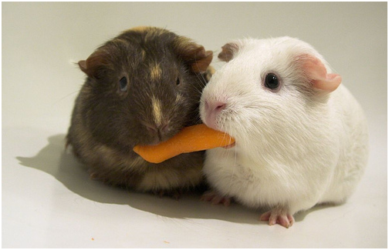
Share with the larger group
Share an observation from your Outside Task #1 discussion with the larger group.
Notes:
Share one of these observations from each pair/group with the whole group. If time permits, have those who haven’t shared share out as well.

Slide 7

TIF-ed Lesson: Try it Out! – Outside Task #2
Move to your working groups.
Share the TIF-ed lesson plan/learner plan or materials you tried in your class with your working group.
Next, share the TIF complements to this lesson. Discuss!
What did you assess?
What skills and sub-skills from your category did it contain?
How did you enhance this lesson/material? What skills did you add?
How did it go?
Notes:
TIF-ed Lesson: Try it Out! Outside Task #2. (30 min-slides 7-8)
Share the TIF-ed lesson plan/learner plan or materials tried in their class with their working group:
What lesson did they assess? What skills and sub skills from their category did it contain?
How did they complement the lesson? What skills and sub skills from their category did they add?
Share their “evaluation” of their lesson with their working group. How did students do? What skills did they demonstrate? What skills do they need more practice with?

Slide 8
Share with the larger group
Share one “TIF-ed” lesson/ materials from your working group discussion with the larger group.
Any further complements to this lesson?
Notes:
Share one of the lessons from each working group with the larger group. Participants focusing on other categories will listen to the description of the lesson and choose sub skills from their category to further complement the lessons presented. The presenter can note skills and sub skills from the other categories on their ACES Process grid. Explain that after the break we will “evaluate” further and “study & reflect”.

Slide 9
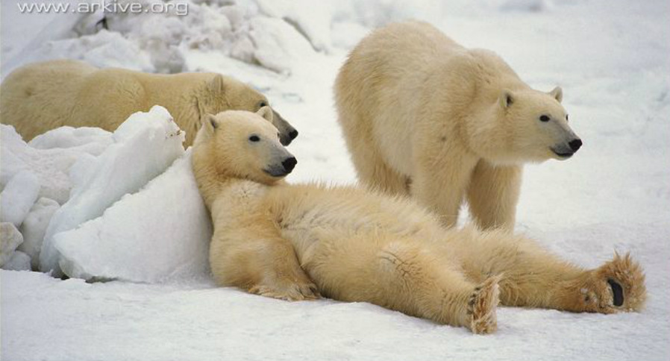
Break
Notes:
15 minute break
When participants return from break, take a quick temperature of the group. How are they doing? Anything we did that was confusing? That needs clarification? Etc.

Slide 10

How do you know it’s working?
Student Evidence: what ‘evidence’ can be used to evaluate your TIF-ed lessons?
Watch a video and note evidence of student learning.
Link: http://mlots.org/Elana/numbersflash/numbers.html
What are ways to improve our evaluation of TIF-ed lessons by using student evidence?
Notes:
Evidence of Student Learning (Handout p. 22) (25 min)
Play the video by clicking on the link on the PowerPoint slide. Skip over the intro of the lesson in the beginning and the teacher’s reflection at the end. Enlarge video with control + (Firefox or Explorer) or browser menu “Zoom” feature (Google Chrome). Watch a brief video and note evidence of student learning. Share and discuss. On page 9 of the PLC Activities doc, there are possible answers listed for you to refer to.
Discuss what “student evidence” can be used to “evaluate” lessons. Return to the ACES Process Grid from Outside Task #2 and add notes to their “evaluate” column as needed based on this discussion. Discuss ways to improve one’s evaluation by using “student evidence” as its basis.

Slide 11
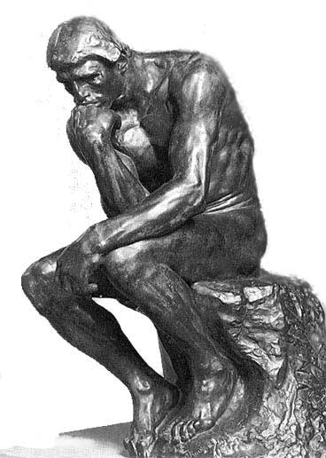
Take a moment to think quietly
Reflect on the TIF-ed lesson you brought for Outside Task #2.
Write notes on handout.
What evidence of student learning did you observe?
What skills do your students need more practice in?
What more do you need to learn about?
What guidance would be helpful?
What could/would you do differently next time?
Notes:
Study and Reflect (Handout p. 23) (10 min)-slides 11-12)
Individually reflect on their lesson. What evidence of student learning did you observe? Based on this, what skills do your students need more practice in? What more do you need to learn about? What help do you need? What could/would you do differently next time?
Have two or three participants share out their reflections with the larger group.

Slide 12
Think/Pair/Share
Reflect on how you thought the lesson went for you as an instructor. Then share with a partner and the larger group if you wish.
How did the lesson go for you?
What was especially positive?
Where did you feel challenged? Surprised? Excited?
Notes:
Study and Reflect
Think/Pair/Share: Reflect on your thoughts about how the lesson went as an instructor and answer the questions on slide.

Slide 13

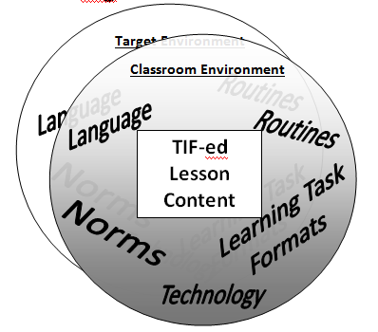
TIF Your Classroom!
What are some ways that TIF skills can be integrated into an instructional setting regardless of lesson content?
Notes:
TIF-ing the Classroom visual (Handout p. 24) (10 min-slides 13-14)
Explain the “TIF-ing the Classroom” visual. Describe how the inner box represents the TIF-ed lesson content while the TIF methods outside the box transcend content, i.e. can be used/done with or regardless of any content. Explore the different ways TIF skills can be integrated into an instructional setting regardless of lesson content.

Slide 14
TIF-ing the Classroom:
Definitions of TIF-ing Methods
Routines: a sequence of actions regularly followed; a routine process
Norms: standards of acceptable behavior; expectations within a specified context
Learning Task Formats: routine structures for activities and tasks that provide practice of lesson content
Language: vocabulary and language structures that are necessary to effectively address a specified TIF skill
Technology: technology use that mirrors what is necessary in the “target” environment.
Notes:
Read the TIF-ing Methods handouts (p. 24-25) and discuss.
Handout:
TIF-ing Methods
This TIF-ing the Classroom model presents the classroom environment as a mirror of the target environment, i.e. the environment into which your students plan to transition such as post-secondary education and training, the workplace, or increased participation in one’s community or family. Inside the box, is the lesson content with integrated TIF skills. Outside the box, within the circle of the classroom environment, are the methods we can use to integrate TIF skills regardless of lesson content. Although there are 5 listed, we will focus on the following 3 methods:
Routine: a sequence of actions regularly followed
Norms: standards of acceptable behavior; expectations within a specified context
Learning Task Formats: routine structures for activities and tasks that provide practice of lesson content
Discus Norms vs. Routines (Handout p. 25)

Slide 15
Which TIF-ing method is which?
TIF-ing methods can be labeled in more than one way:
  Expecting students to email assignments is both technology and a norm.
  Expecting students to speak courteously is a norm but when you highlight the language structures (e.g. Could/can/may I…), it is also a language method.
The important thing is that all of these methods reinforce TIF skills consistently and authentically regardless of lesson content.
Notes:
Offer or elicit other examples as needed.

Slide 16
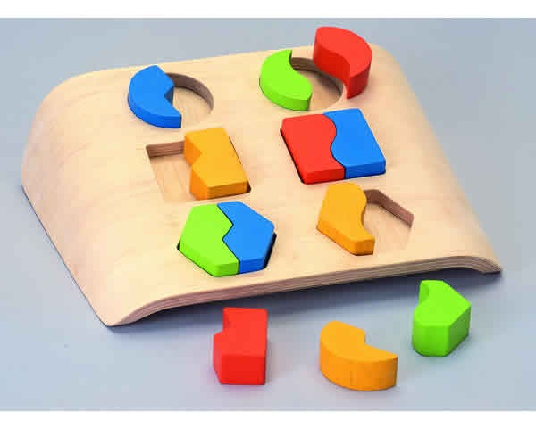
Routines, Norms & Learning Task Formats – TIF your classroom!
Is this a routine, a norm, or a learning task format?
Matching activity
Match 3 methods to each method label.
Write down 1 or 2 examples on the grid.
Write the TIF skills and sub skills it addresses from your category
Complement it with additional skills and sub skills
Notes:
Activities (pp. 10-15) (Participant Handout p. 26) (30 min)
Refer to TIF-ing the Classroom: Facilitator Instructions (Activities p. 10). Sort examples of routines, norms, and learning formats into the three categories labeled “routines”, “norms”, and “learning formats” according to what they primarily fit with. There will be 3 examples per method label.
*There will be debate around where these examples should go. The important thing is not that they fit with the designated category but that the participants can logically explain why they chose to put it in the category they did.
After the matching, participants will write down one or two of the examples on the grid (Participant Handout p. 26) and the TIF skills & sub skills it contains from their category of focus.
Finally, they will note ways they could enhance this TIF-ing method in the “Complement” column.

Slide 17

Outside Task #3 –Routines, Norms, & Learning Task Formats
Using the matching activity and our discussion, consider which routine, norm, and learning task format you can integrate into your setting and which TIF skill(s) it addresses.
Implement two ideas (from two of the three TIF methods) into your classroom before meeting 3
Evaluate how it’s going by gathering ‘student evidence.’
Come prepared to share this evaluation at the next meeting!
Notes:
Outside Task #3 (Handout p. 27) (5 min)
Consider which routine, norm, and learning format they can integrate into their setting and which TIF skills/sub skills these address. Implement two ideas (from two of the three TIF methods) into their classroom before meeting 3 and evaluate their implementation by observing “student evidence”. Note all information on the ACES Process Grid and prepare to share this information at meeting 3.
Challenge: Consider all methods of TIF-ing a classroom and integrate one of each into their classroom before meeting 3. Evaluate and prepare to share at Meeting 3.

Slide 18

Outside Task #4 – TIF-ed Lesson: Try it Out 2!
Revisit the ACES Process.
“TIF” another lesson or materials of your choice, focusing on your one TIF category.
Try this “TIF-ed” lesson out with learners.
Evaluate how it went.
Be ready to share your response at Meeting Three.
Notes:
Outside Task #4 (Handout p. 28) (5 min-slides 17-18)
“TIF” another lesson/learner plan or materials using the ACES Process grid and try it out with your class. Use your improved evaluation based on meaningful “evidence” in the “evaluate” column. Complete the “study & reflect” column as well. Bring the ACES Grid along with the lesson/learner plan or materials to share at meeting 3.

Slide 19
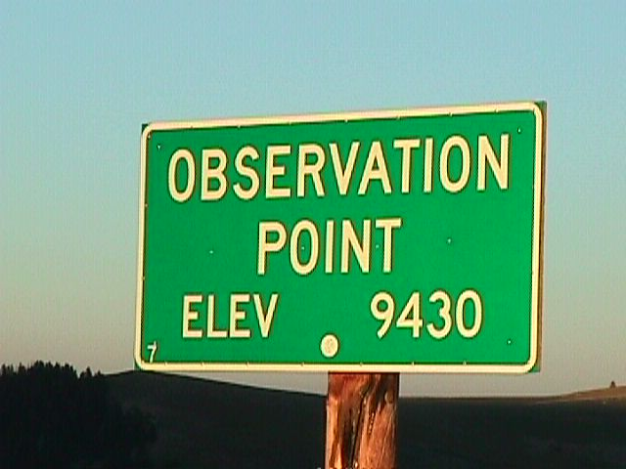
Outside Task #5 – Lesson Observation through TIF Lens
Apply the ACES process to an observation of a colleague’s lesson or a lesson video.
Note the TIF skills and sub-skills it includes (particularly from your category of focus).
Consider ways to “TIF” the lesson you observed.
What else do these students need? Study and reflect.
Videos to observe in lieu of a peer:
ESL: http://www.newamericanhorizons.org/training-videos
ABE: http://mlots.org/wendy/wendy.html
Notes:
Outside Task #5 (Handout p. 29)
Discuss the Observation assignment. Encourage them to observe a peer but allow a video (option btw ESL & ABE) to be observed if this is not possible. Using the ACES Process Grid, have them observe this lesson noting TIF sub skills it includes (especially from their category) and “complementing” that lesson with potential TIF sub skills after their observation. “Evaluate” the lesson using “student evidence” as a basis for the evaluation. “Study and reflect” by considering what more these students need.
Videos for Observation in lieu of peer observation:
ESL: http://www.newamericanhorizons.org/training-videos
(Choose any of the several available videos.)
ABE: http://mlots.org/wendy/wendy.html

Slide 20

Wrap-Up
Think/Pair/Share:
My biggest take away from this meeting is…
Notes:
Wrap-Up (5 min-slides 19-20)
For a wrap-up, have each participant share their “biggest take-away” from this PLC meeting.

Slide 21

Next Steps
Next Meeting: day, time, place
Tasks before we meet again?
Come ready to share!
THANK YOU!!!
Notes:
Go over the logistics of the next meeting: day, time, place.
Discuss outside tasks and questions.

