Slide 1

ACES Professional Learning Community II
Meeting Three
Notes:
Handouts:
ACES PLC II Participant Workbook (Complete document 3-hole punched in 3-ring binder--Recommended; or pp. 26-32)
The Complete TIF (Complete document or pp. 62-67)
TIF at a Glance (Complete document or p. 12)
Materials/Technology:
Projector (preferred)
Internet access (required)

Slide 2

Welcome!
Hello again!
Notes:
Welcome, Agenda, & ACES Goal Checkpoint
(10 min)
Slides: 2-4; HO p. 27, 12
Welcome participants.

Slide 3
Meeting THREE Agenda
ACES Goal checkpoint
Sharing Outside Task #4: TIF-ed lesson Try It Out 2!
Sharing Outside Task #5: TIF Method Implementation
Zoom in on Navigating Systems (NS)
  Pre-Task #1: Student Goals (Revisited with NS)
  NS sample activities in the complete TIF
A Tale of Two Contexts: The ACES Process with NS
  The Classroom
  The One-room schoolhouse
Exploring TIF Methods
Work Time! TIF-ed Instructional Planning
ACES & CCRS
Wrap-up & questions
Notes:
Agenda
HO p. 27
Hand out the PLC Meeting THREE agenda (p. 27). Go over the agenda, beginning with a check-in to see if outside tasks were completed.
Remind everyone that this meeting will focus on Navigating Systems (NS).

Slide 4

ACES Goal…
Look at the ACES goal you wrote at our first PLC meeting (p. 12)
How close are you to accomplishing your ACES goal?
Discuss:
What have you already accomplished?
What have you yet to accomplish?
We will revisit this discussion at the end of this meeting!!
Notes:
ACES Goal Checkpoint
HO p. 12
Look at the goal you wrote on hangout p. 12. How close are you to accomplishing your ACES goal? Discuss:
What have you already accomplished?
What have you yet to accomplish?
Note: This goal will be revisited at the end of this meeting.

Slide 5
TIF-ed Lesson: Try it Out 2! Outside Task #4
In a small group, share your TIF-ed lesson plan/materials.
Then share out some examples with the larger group.
What LS skills did it integrate?
What did the lesson entail?
How did it go?
What evidence of learning did you observe?
Notes:
Sharing Outside Task #4: TIF-ed Lesson Try It Out 2!
(15 min)
Slide: 5; Completed IPT & notes for Outside Task #4
In small groups, participants will share the TIF-ed lesson they implemented, including their evaluation and their study &reflection of the lesson. One person from each group can then share with the full group.
Guiding Questions:
What LS skills did it integrate?
What did the lesson entail?
How did the lesson go? What evidence of learning did you observe?
What went well? What would you do differently next time?

Slide 6
Outside Task #5: TIF Method Implementation
Share your TIF Method implementation with a small group.
Describe the TIF Method
Identify the LS skills it addressed
How did it go? [evidence of learning]
Would you do anything differently next time? If so, what?
Notes:
Sharing Outside Task #5: TIF Method Implementation
(15 min)
Slide: 6; Notes on TIF Method implementation
In small groups, have participants share the TIF Method they implemented in their settings.
Have a couple of participants share out with the larger group.

Slide 7

My learner’s goals
Revisit Pre-Task #1
  In a pair/small group, review your learners’ long-term goals and the steps they need to get there.
  Look at the final column of your worksheet you labeled “TIF Skills.”
  Take out the TIF @ a Glance and look at the NS category (p. ).
  Together, consider (and jot down on handout p. 4) which NS skills and sub skills your students need to develop in order to take the steps they need to achieve their long-term goals.
Notes:
Student Goals: Review Pre Task #1 from Meeting ONE
(15 min)
Slides: 7-8; HO p. 4
Review Pre-Task #1 from meeting ONE, student goals. In small groups, have participants refer to the NS category of their TIF at a glance (p. 12). Discuss which skills the interviewed students need in the NS category. Identify the skills & sub skills needed and share with the group. (This will be the introduction or review of the NS category to set up this meeting so get specific with the skills/sub skills.)

Slide 8


Helping my student meet his/her goal…
Given the NS skills and sub skills your student needs to succeed…
    Which NS skills do you already teach?
    Which NS skills do you need to add?
Notes:
After they discuss the skills & sub skills, have them answer these 2 questions:
What skills do you already teach in this category?
What skills would you like to add?

Slide 9
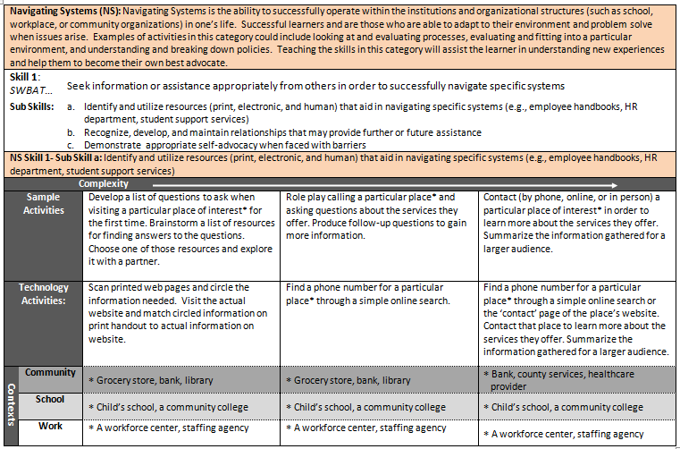
The Complete TIF
Notes:
NS Sample Activities: The Complete TIF
(15 min)
Slides: 9-10; HO p. 28; Complete TIF pp. 62-67
Refer participants to the NS category of The Complete TIF (pp. 62-67).

Slide 10
The Complete TIF
Transitions
Integration
Framework
Navigate the complete TIF to find sample activities for the NS sub-skills (pp. 62-67).
Choose 2 sample activities you could tweak and use with your students. (1 must be a technology activity.)
Discuss your choice with your partner/group.
Then share out sample activity “finds” with the large group. How could this activity work in different contexts?
Notes:
TIF Sample Activity Search
HO p 28
Have participants complete the activity on Handout p. 28.
Read the sample activities provided
Choose at least 2 sample activities you could try with your students. Make sure at least one of them is a technology example.
Fill out the grid with your choices & tweaks. Make sure to include the NS skills and sub skills addressed.
Share your “finds” and “tweaks” with the group.
Challenge: create additional sample activity descriptions for TIF sub skills that are not yet accompanied by sample activities.

Slide 11
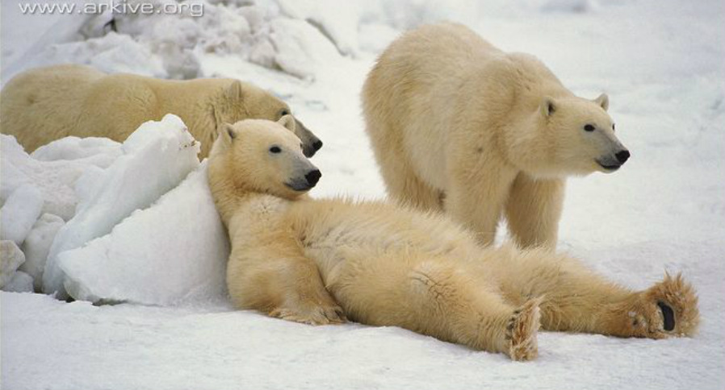
Break
Notes:
15 minute break

Slide 12



A Tale of Two Contexts…
The Classroom:
Corrections
Notes:
A Tale of Two Contexts: The ACES Process
The Classroom
(30 min)
Slides: 12-32; HO pp. 29-30; TIF @ a Glance p. 12
Explain that we will once again look at applying the ACES process to the contexts of the classroom and corrections, this time looking at the NS category (TIF @ a Glance, p. 12).

Slide 13
ACES Process: Step 1: Assess a Lesson
Sample “Pre-ACES” Lesson
Read and ASSESS the Pre A-C-E-S Lesson Plan to identify the Navigating Systems (NS) skills/sub skills being addressed.
    Read the description of each lesson component and identify the NS skills and sub skills addressed.
    Refer to the “TIF @ a Glance” NS category (p.12).
    Note the skills and sub skills in the “Assess” column for each lesson component (e.g. NS 1a, 2b)
Remember, the ACES process can be used with textbook materials, learner plans, and other instructional resources and routines, not just lesson plans.
ACES can work in any ABE context!
Notes:
ACES Process: The Classroom
Slides 12-21; HO pp. 29-31; TIF @ a Glance p. 12
Share the pre-ACES NS lesson (Side-by-Side pp. 30-31) and together identify the skills and sub-skills it addresses and write them on the TIF-ing the classroom grid (p. 29).

Slide 14
Pre-ACES Lesson Plan
Warm-up
Warm-up:
NA
Notes:
What NS skills do you see?

Slide 15
Pre A-c-e-s Lesson: Assess
Lesson Components | Assess | Complement | Evaluate | Study & Reflect
Warm-Up
Introduction
Guided Practice
Independent Practice
Extension
NA
Notes:
Have participants check their answers on their grid with this slide. “Click” to reveal the skills one row at a time.

Slide 16
Pre-ACES Lesson Plan
Introduction
Introduction:
Explain the basic concept of a learning styles inventory to Ss.
Brainstorm with Ss examples of each learning style and what it could look like in a classroom setting.
Explain to Ss that they are going to have an opportunity to take a learning style inventory online to help them determine how they may best learn.
Notes:
What NS skills do you see?

Slide 17
Pre A-c-e-s Lesson: Assess
Lesson Components | Assess | Complement | Evaluate | Study & Reflect
Warm-Up
Introduction
Guided Practice
Independent Practice
Extension
NA
NS 1a
Notes:
Have participants check their answers on their grid with this slide. “Click” to reveal the skills one row at a time.

Slide 18
Pre-ACES Lesson Plan
Guided Practice
Guided Practice:
Model with Ss how to use the online learning style inventory.
Remind Ss they should think about the statement carefully before choosing their answer.
Model how to submit answers and review the corresponding learning style inventory.
Notes:
What NS skills do you see?

Slide 19
Pre A-c-e-s Lesson: Assess
Lesson Components | Assess | Complement | Evaluate | Study & Reflect
Warm-Up
Introduction
Guided Practice
Independent Practice
Extension
NA
NS 1a
NS 1a
Notes:
Have participants check their answers on their grid with this slide. “Click” to reveal the skills one row at a time.

Slide 20
Pre-ACES Lesson Plan
Independent Practice
Independent Practice:
Ss will perform an online learning style inventory.
Help Ss complete the learning style inventory (note or print results as needed).
The online learning style inventory (http://www.personal.psu.edu/bxb11/LSI/LSI.htm) consists of 24 questions and should take about 10 – 15 minutes.
Notes:
What NS skills do you see?

Slide 21
Pre A-c-e-s Lesson: Assess
Lesson Components | Assess | Complement | Evaluate | Study & Reflect
Warm-Up
Introduction
Guided Practice
Independent Practice
Extension
NA
NS 1a
NS 1a
NS 1a
NA
Notes:
Have participants check their answers on their grid with this slide. “Click” to reveal the skills one row at a time.

Slide 22
ACES Process: Step 2: Complement
  Now watch the video clip of the “Post-ACES” TIF-ed lesson. Access video: https://www.youtube.com/watch?v=V9t1z23_Y40&feature=em-uploademail
  How did the teacher COMPLEMENT the lesson with additional NS skills and sub skills?
      Refer to the TIF @ a Glance NS Snapshot.
      Note the skills and sub skills on the GRID in the “complement” column.
  Share out skills & sub skills
Notes:
Post-ACES Lesson
Continue working from the TIF @ a Glance and TIF-ing a Lesson Grid (p. 29). Click the video link to show the video.
Watch the Post-ACES Lesson one segment at a time as indicated on the TIF-ing the Classroom Grid (p. 29) and the slides.
Identify the skills & sub skills from each segment and jot them on the grid (p. 29) after watching each segment .
Check your notes with the slides.
Reflect on the ‘E’ and ‘S’ of the ACES Process for this

Slide 23
Post-ACES Lesson Plan
Warm-up
Warm-up: [0:00-7:10]
Brainstorm with Ss on learning styles and methods of learning. Try to elicit examples of each learning style and what it could look like in a classroom setting. (Visual = seeing and reading – Auditory = listening and speaking – Kinesthetic/Tactile = touching and doing)
Notes:
What NS skills did you see?

Slide 24
Post A-c-e-s: Complement
Lesson Components | Assess | Complement | Evaluate | Study & Reflect
Warm-Up | NA
Introduction | NS 1a
Guided Practice | NS 1a
Independent Practice | NS 1a
Extension | NA
NA
Notes:
Participants can share out their ideas for complements. “Click” to reveal the complements for each row, one at a time.

Slide 25
Post-ACES Lesson Plan
Introduction
Introduction: [7:10-9:04]
Explain to Ss that they will take a learning style inventory online to help them determine how they may best learn.
Model with Ss the online learning style inventory.
Remind Ss they should think about the statement carefully before choosing an answer.
Model how to submit answers and review the corresponding learning style inventory.
Ss then perform their own learning style inventory and record results.
Notes:
What NS skills did you see?

Slide 26
Post A-c-e-s: Complement
Lesson Components | Assess | Complement | Evaluate | Study & Reflect
Warm-Up | NA
Introduction | NS 1a
Guided Practice | NS 1a
Independent Practice | NS 1a
Extension | NA
NA
NS 1a
Notes:
Participants can share out their ideas for complements. “Click” to reveal the complements for each row, one at a time.

Slide 27
Post-ACES Lesson Plan
Guided Practice
Guided Practice: [9:04-13:12]
Explain to Ss that they will do a jigsaw reading on learning style inventories and strategies
Put Ss into 3 groups based on their learning style Group A=auditory learners, Group B= visual learners, Group C=tactile/kinesthetic learners
Distribute the various parts of the handout to the groups. They will follow the directions.
Ss present their sections to the class while other Ss take notes on each style presented.
Notes:
What NS skills did you see?

Slide 28
Post A-c-e-s: Complement
Lesson Components | Assess | Complement | Evaluate | Study & Reflect
Warm-Up | NA
Introduction | NS 1a
Guided Practice | NS 1a
Independent Practice | NS 1a
Extension | NA
NA
NS 1a
NS 1a; 2b; 2d
Notes:
Participants can share out their ideas for complements. “Click” to reveal the complements for each row, one at a time.

Slide 29
Post-ACES Lesson Plan
Independent Practice
Independent Practice: [13:12-16:30]
Ss will review material pertaining to their own learning style and develop a plan that includes strategies that support their preferred method of learning.
Ss will fill out information in Educational Plan and Testing Log document.
Notes:
What NS skills did you see?

Slide 30
Post A-c-e-s: Complement
Lesson Components | Assess | Complement | Evaluate | Study & Reflect
Warm-Up | NA
Introduction | NS 1a
Guided Practice | NS 1a
Independent Practice | NS 1a
Extension | NA
NA
NS 1a
NS 1a; 2b; 2d
NS 1a; 2b; 2d-2e
Notes:
Participants can share out their ideas for complements. “Click” to reveal the complements for each row, one at a time.

Slide 31
Post-ACES Lesson Plan
Extension
Extension: [16:30-17:46]
Ss will use the Education Plan and Testing Log with teacher during conferences.
After a few weeks of learning plan implementation, Ss will reflect on the plan and make adjustments as needed.
Notes:
What NS skills did you see?

Slide 32
Post A-c-e-s: Complement
Lesson Components | Assess | Complement | Evaluate | Study & Reflect
Warm-Up | NA
Introduction | NS 1a
Guided Practice | NS 1a
Independent Practice | NS 1a
Extension | NA
NA
NS 1a
NS 1a; 2b; 2d
NS 1a; 2b; 2d-2e
NS 1a; 2b; 2d-2e
Notes:
Participants can share out their ideas for complements. “Click” to reveal the complements for each row, one at a time.

Slide 33
Corrections
Read the interview with the instructor in a corrections setting. (Extra handout)
Consider the system she uses to TIF the lessons for her learners.
What kind of IPT does she use? How does she use it?
What kinds of pre-ACES materials does she use and how does she TIF them?
Notes:
A Tale of Two Contexts: The ACES Process
Corrections
(20 min)
Slides: 33-34; HO p. 16
Read the interview with the instructor in a corrections setting.
Consider the system she uses to TIF the lessons for her learners.
What kind of instructional planning tool does she use in this setting? How does she use it?
What kinds of pre-ACES materials does she use and how does she TIF them?

Slide 34
What works best in my setting?
Consider both the classroom and corrections contexts. In small groups, discuss these questions:
Which process would work best in your setting? (Classroom, corrections, other?)
Why did you choose that option?
How would you tweak either process to better fit your setting and learners?
Is there a way to combine the two processes to get the best of both worlds?
Notes:
Which is the Right Fit for Me?
HO p. 16
Revisit notes from PLC Meeting ONE (p. 16)
What are your take-aways from ACES implementation in these two contexts?

Slide 35
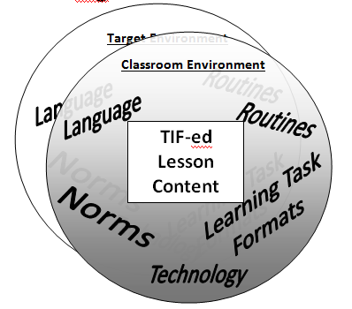
TIF Methods
Notes:
TIF Methods
(10 min)
Slides: 35-36
Review the types of TIF Methods.

Slide 36
TIF Methods Definitions: Matching
Routines
a sequence of actions regularly followed; a routine process
standards of acceptable behavior; expectations within a specified context
routine structures for activities and tasks that provide practice of lesson content
vocabulary and language structures that are necessary to effectively address a specified TIF skill
technology use that mirrors what is necessary in the “target” environment.
Norms
Learning Task
Formats
Language
Technology
Now it’s your turn to think of some TIF Method examples!
  Look at p. 32
  In a small group, share TIF Methods that address NS skills
  Assess and Complement them with NS skills
Notes:
Reveal each definition and have participants shout out the TIF Methods.
In pairs or small groups, have participants discuss which TIF methods they could implement in their settings to integrate NS skills (p. 32).
Describe TIF methods
Assess the methods for NS skills and sub skills
Complement the methods with NS skills and sub skills
Have several participants share their examples with the larger group.

Slide 37

Work Time!
Tools:
Instructional Planning Tool
NS Lesson materials
Instructions:
Team up with someone with a similar context or learner group
Discuss your proposed ACES lessons
Identify the NS skills/sub skills to be addressed & note them on the IPT
Provide input and feedback to one another
Notes:
Work Time! Instruction Planning
(20 min)
Slide: 37-38; IPT and Lesson Materials from Outside Task #6
Have participants take out their lesson materials they brought as part of the requirements for Outside Task #6. In pairs, have participants discuss their proposed ACES lessons and get feedback from their partner. Participants will use their IPT for their instructional planning noting the NS skills/sub skills they intend to address and how they intend to address them.
In addition, they can discuss which TIF Method they will integrate into their classroom and which NS skills it addresses.
Ask 2 or 3 participants to share their plans with the larger group.

Slide 38
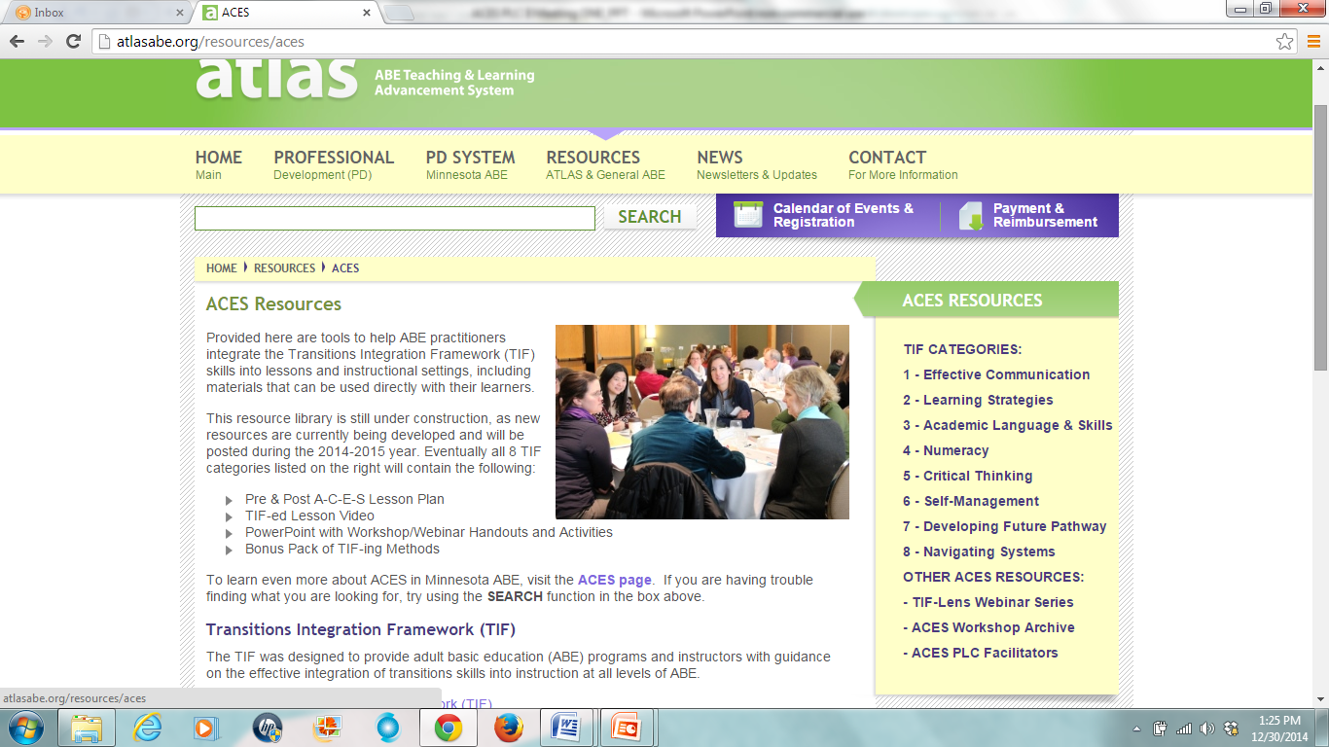
ACES Resource Library
http://atlasabe.org/resources/aces
Notes:
Share the ACES resource library for the NS category.

Slide 39

Next Steps
Take some time to reflect on your ACES work.
Where did you start with ACES?
What challenges did you face?
How do you feel about your progress as an ACES practitioner?
Did you meet your ACES goal in this PLC? Why or why not? (p. 12)
What are your next steps for ACES?
Notes:
ACES Journey
(7 min)
Slide: 39; HO p. 12
Revisit participants ACES goals. This time have participants discuss their overall ACES journey and their next steps with ACES:
Where did you start with ACES?
What challenges did you face?
How do you feel about your progress toward becoming an ACES practitioner?
What challenges have you overcome?
Did you meet your ACES goal in this PLC? Why or why not? (Handout p. 12)
What are your next steps for ACES?

Slide 40


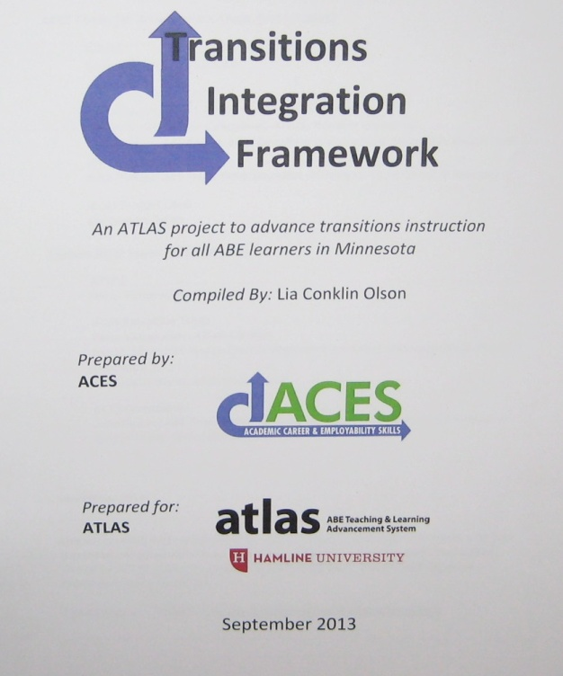
ACES & CCRS
The TIFs transferable transitions skills complement CCRS academic-based skills.
Academic Language & Skills and Numeracy aligned. Effective Communication, Learning Strategies, and Critical Thinking also support CCRS skills.
Notes:
ACES & CCRS:
(3 min)
Slides: 40-41
Discuss the alignment between ACES and the College & Career Readiness Standards (CCRS).
Explain that the College Career & Readiness Standards are the new instructional standards for ABE in Minnesota. Explain that many of these standards in the CCRS are already being addressed through other professional development venues, such as Minnesota Numeracy Initiative (MNI), STAR Reading and Evidence Based Reading Instruction (EBRI), GED professional development, and, of course, the ACES project. Discuss how the TIF provides a framework for the transferable transitions skills required for employability, career, post-secondary education & training, and increased involvement with community and family. As the CCRS does not contain most of these essential transitions skills, the TIF nicely complements the academic-based skills addressed in the CCRS. Furthermore, it aligns with the CCCRS in the categories of Academic Language & Skills and Numeracy and to a lesser degree Effective Communication, Learning Strategies, and Critical Thinking.

Slide 41
A-C-E-S Process & CCRS
The A-C-E-S Process (Assess, Complement, Evaluate, Study & Reflect) can be used with any set of standards.
    Start with an existing lesson or lesson materials.
    Assess the lesson for CCRS standards it already addresses
    Complement the lesson/materials with additional CCRS standards
    Evaluate the lesson using evidence of student learning
    Study & Reflect…What more do I/my students need?
Notes:
ACES Process & CCRS
Discuss how the ACES process can be used with any standards. As we begin to integrate the CCRS standards into our teaching, we can directly apply the skills we developed through this ACES PLC by following the steps in the ACES process. Through the ACES process, we discovered that we already integrate many TIF skills into our instruction and that by being intentional about it, we can add more to our repertoire. The same thing will be true as we begin to work with CCRS. We will discover that we already integrate many CCRS standards and that with some intentional modifications, we can integrate more.

Slide 42

CEUs for You!
You PLC facilitator will fill out a report
to request CEUs for PLC work completed (http://atlasabe.org/resources/aces/aces-plcs)
Here’s the breakdown:
Three 3-hour PLC meetings = 9 CEUs (3 each)
Pre-Tasks #1- #2 = 2 CEUs
Outside Tasks #1- #3 = 2 CEUs
Outside Tasks #4- #6 = 2 CEUs
TOTAL: =15 CEUs
Notes:
Wrap-up/Q & A
(5 min)
Slide: 42-43
Explain that you will submit a report to get CEUs for them according to the completion of the following elements:
PLC meetings: 3 meetings x 3 CEUs = 9 CEUs
Pre-Tasks #1-3 = 2 CEUs
Outside Tasks #1-3 = 2 CEUs
Outside Tasks #4-6 = 2 CEUs
TOTAL = 15 CEUs

Slide 43

Thank you & Wrap-up
THANK YOU for participating in an ACES Professional Learning Community!
miigwech
Notes:
Wrap up & Q&A
Answer questions.
Thank everyone for participating.

